Slide 1
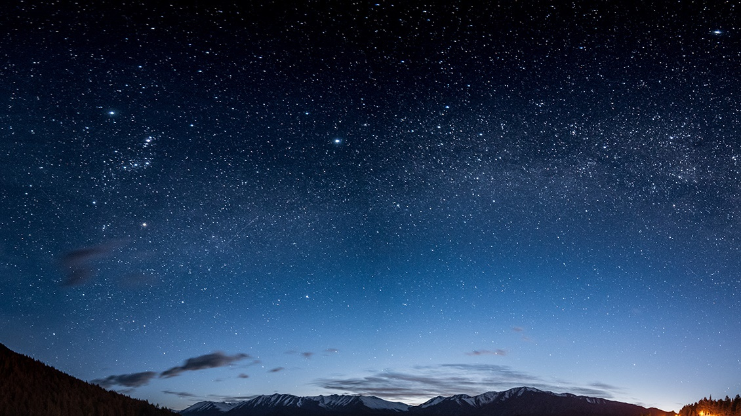
Smart Sports Venue
BY: Bibhudatta Sarangi and
James Rosebaugh-Nordan

Slide 2

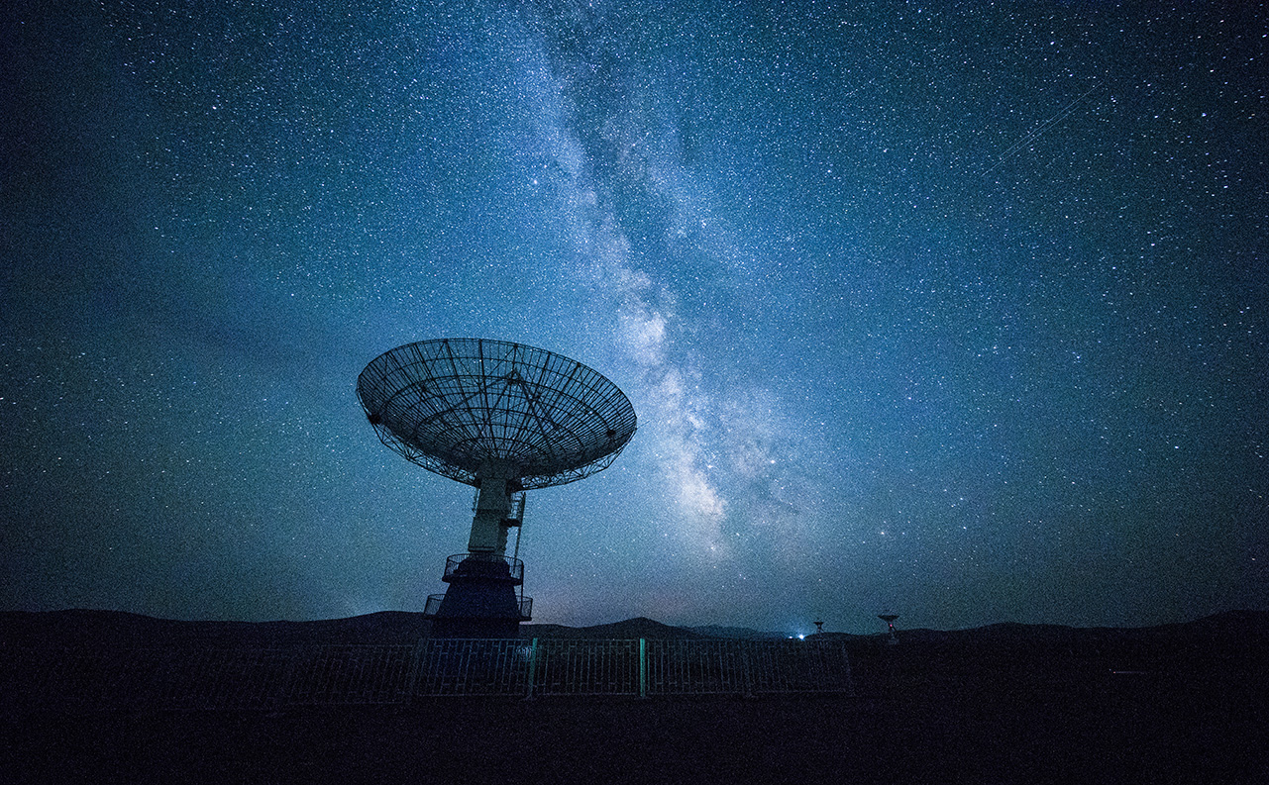

Smart Field Technology
The Full Picture:
We wanted to design an outdoor sporting arena that could autonomously notify fans and other key personnel about adverse weather conditions when they arose.
We wanted people to know if there was:
Too much rain
Too much Sun (UV warning)
High winds

Slide 3
WHO WOULD BE NOTIFIED
We planned to have a database with practices, games and other events listed, along with what types of people would be attending each event along with a list of people with a type, name and contact info. We would hope to offer SMS or email notifications.
For any weather events, maintenance staff would be notified.
For weather events coinciding with practice days, coaching staff and players would be notified.
For weather events on game days, everyone (players, coaches, staff and ticketholders) would be notified.

Slide 4

Triggering
What kinds of triggers would be used:
UV warnings would be sent out for any levels where sunscreen is highly recommended within a short timeframe of the event.
Rain would be measured at several points around the field and the total moisture saturation would be considered and if there was a certain level of water on the field, the event would be cancelled
High winds that would be considered dangerous within a short timeframe that may cause a delay or cancellation would also trigger a notification.

Slide 5
Our prototype:
What we included:
2 moisture sensors that detect moisture over a set timeframe and trigger emails if moisture levels reach a certain point.
1 *UV sensor that triggers emails at certain levels
An email system that sends out notifications
One server that collects the information from the 3 separate sensors
A small level of error handling / detection to ensure that only valid emails are being sent

Slide 6
Trouble we encountered and lessons learned
The Counterfit System is still very sparsely documented and even google doesn’t provide much help.
Not all of the modules actually work. We found that the UV sensor was missing an __init__ file and a setup file so it could be installed with pip but not imported and used in the actual code.
Getting readings from sensors is really a small part of a much more complex system when it comes to IoT and CPS.
MQTT servers are very picky about Client and telemetry data. We tried to simplify the code and use one name for telemetry data and differentiate by client names and the data would be duplicated or lost, so we had to use unique client names and telemetry topic names for each sensor.
There is still a lot that can be done with simple systems that has not been done yet which leave the door wide open for anyone with a little knowledge and a business idea.

Slide 7

Thank You!

